Slide 1
Seasonal NHL Predictions :
Ranking, Coach's changes, PIM
Aprendizagem Computacional / Machine Learning Project · NHL
How can we help a General Manager anticipate his season ?
Nathan PINHEIRO | Susana SUECARMOL | Jules COLOMBU · [04/12/2026]

Slide 2
Context

Slide 3
Scope: three prediction tasks
Q1 · Team ranking
Q2 · Coach changes
Q3 · Penalty minutes
Final regular-season ranking of the teams.
Which teams will change coach ?
PIM of each player over the regular season.
[To be completed]
Common assumption: predictions are made the day before the first game of the new season.

Slide 5
Scope: three prediction tasks
Q1 · Team ranking
Q2 · Coach changes
Q3 · Penalty minutes
Final regular-season ranking of the teams.
Which teams will change coach ?
PIM of each player over the regular season.
Common assumption: predictions are made the day before the first game of the new season.

Slide 6
Business Understanding
Business goal
Data mining goal
Predict whether a team will change its head coach during the upcoming season. A GM who knows a coach is at risk can scout replacements and prepare a backup plan.
Binary classification on each team-season: 0 = same coach all season, 1 = coach change.
Main challenge: changes are rare events. A model that always predicts "no change" reaches 84% accuracy on our test set yet is useless, so we optimise the F1-Score instead.

Slide 7
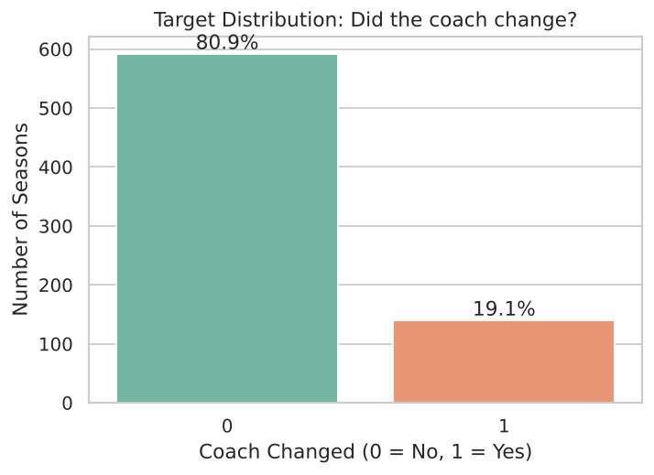
Data Understanding: building the target
Source: historical NHL relational database (Teams and Coaches tables).
Scope: NHL only, seasons after 1979: 732 team-seasons.
Target: coach_changed = 1 if a franchise has more than one coach stint in a season.
Imbalance: about 19% of all seasons, 16% in the test set. Accuracy would mislead, which justifies F1.

Slide 8
Feature Engineering: features known before the season
Previous season
Deeper performance
One-year trends
prev_Pts, prev_rank, prev_playoff
prev_goal_diff, prev_PP_pct (power play), prev_PK_pct (penalty kill), taken from the database schema
pts_change_1y, rank_change_1y, goal_diff_1y
Coach history
Coach tenure
Design principle
prev_coach_changed, changes_last_3y: the franchise's "memory"
coach_tenure, recomputed leak-free from the past only
Every feature describes the team before the season starts, as a GM would see it.

Slide 9
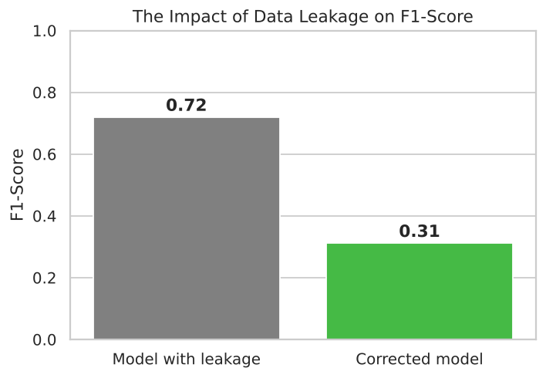
The turning point: data leakage
Initial approach: coach_tenure looked very powerful, with an F1-score of 0.72.
Problem: its computation used the current year's outcome, which is the target. The model was cheating.
Fix: tenure now looks only at the past. After a change last year, the new coach starts at 1, otherwise tenure increments.
Result: F1 drops to 0.31, the realistic and honest performance.

Slide 10
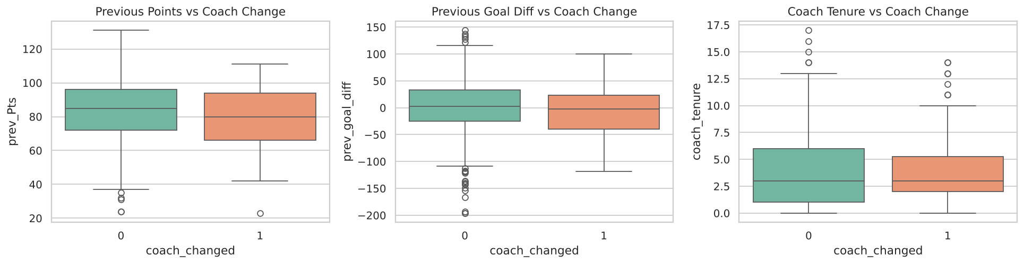
Exploratory Data Analysis
Previous points and goal difference: teams that change coach have slightly lower medians. The signal exists but is weak.
Tenure: coaches in their first or second year are more at risk, like a probation period. After the leakage fix it no longer separates the classes perfectly.
Notes:
Boxplots show whether engineered features carry signal before modelling. Previous points and goal differential are slightly lower for teams that change coach. Short tenures (1-2 years) are more likely to end in a dismissal.

Slide 11
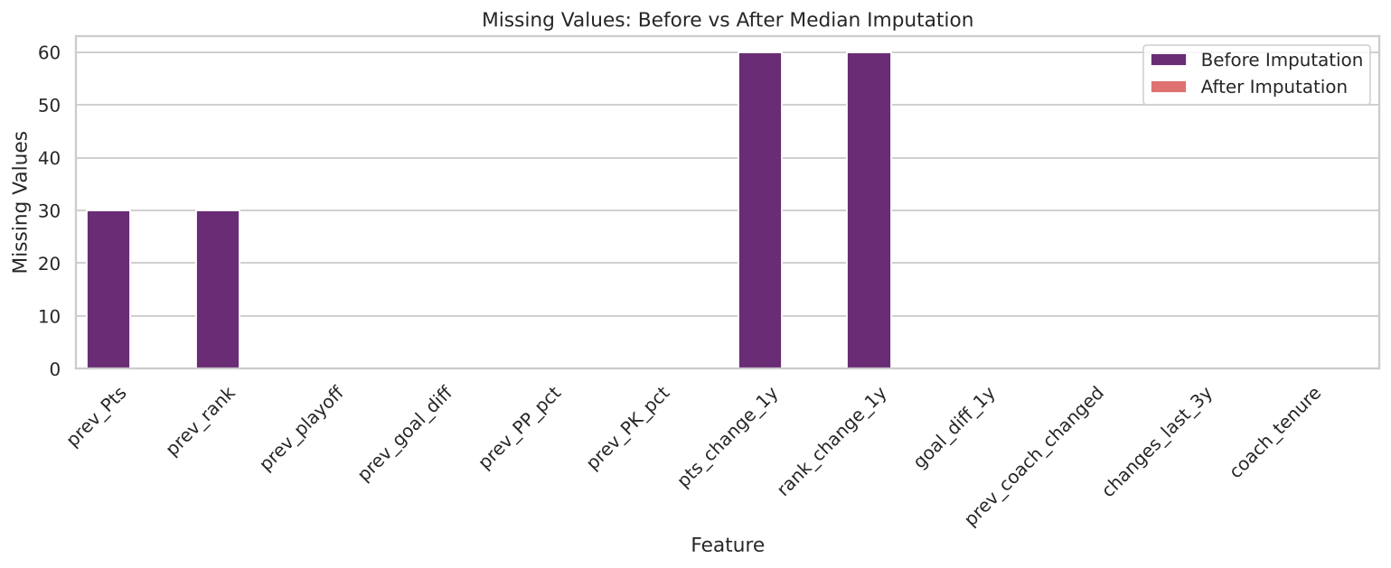
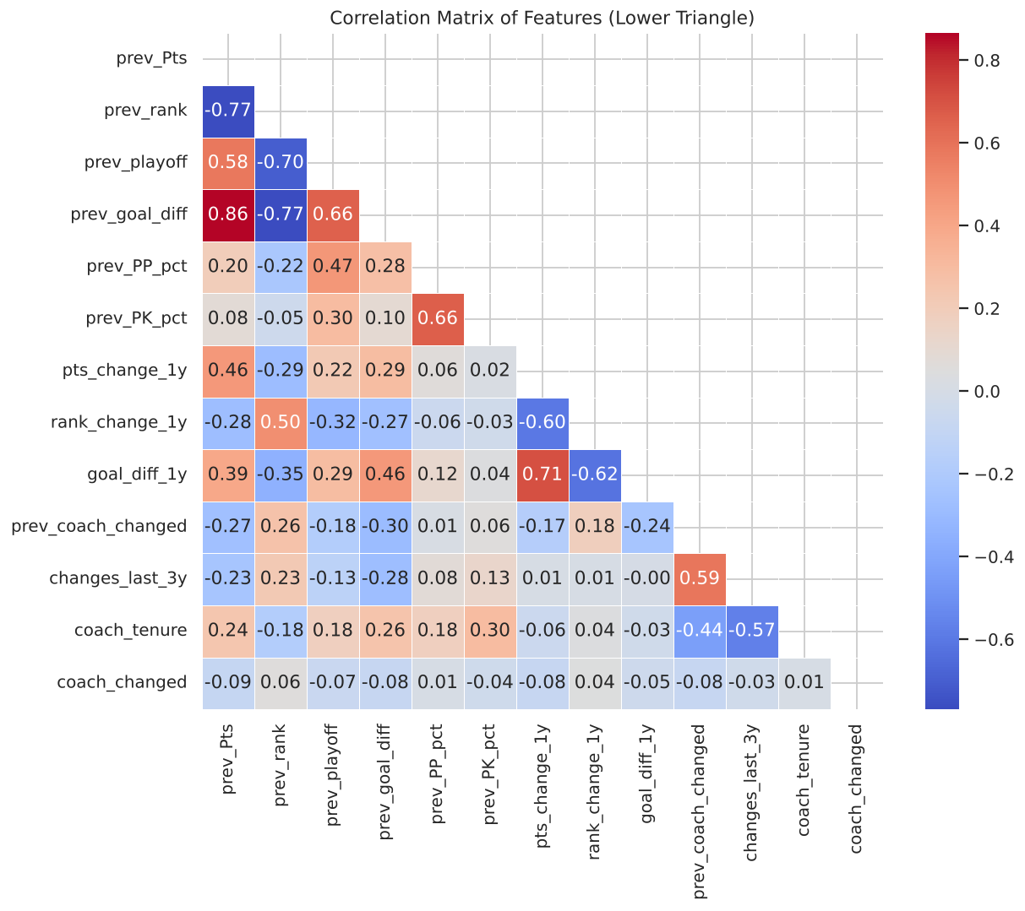
Data quality and preprocessing
Missing values: a franchise's first year has no previous season. Median imputation keeps these rows: 0 missing values remain.
Correlation: features are mostly independent, so there is no multicollinearity risk for linear models.
Scaling: MinMaxScaler keeps large-magnitude variables (points, 80 to 100) from dominating SVM and logistic regression.

Slide 12
Modelling: approach and choices
Chronological split
Threshold optimisation
Train on seasons before 2005 (582 rows), test on 2005 onwards (150 rows). We never predict the past.
We sweep thresholds from 0.1 to 0.9 and keep the one maximising F1, instead of a default 0.5.
Five algorithms
Imbalance handling
Logistic Regression, SVM, Random Forest, Gradient Boosting, XGBoost (100 trees, depth 3, learning rate 0.05).
Class weights for LR, SVM and RF, scale_pos_weight for XGBoost. Baselines: always 0 and random.

Slide 13
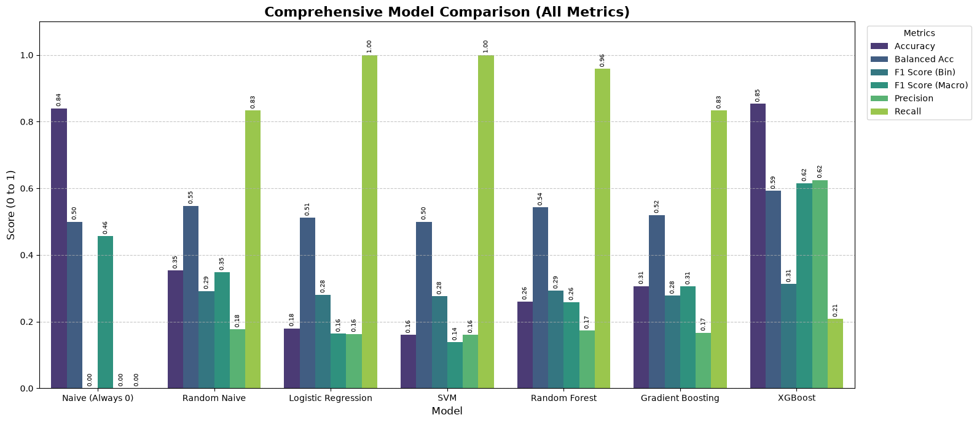
Results: why not accuracy?
The naive model has 84% accuracy but a Balanced Accuracy of 0.50 and F1 of 0. Macro F1 is the most honest metric. XGBoost wins with the best F1 (0.31) and Balanced Accuracy (0.58).

Slide 14
Results: threshold
Model | F1 | Threshold
Naive (always 0) | 0.000 | 0.50
Random naive | 0.292 | 0.20
Logistic Regression | 0.281 | 0.25
SVM | 0.276 | 0.10
Random Forest | 0.293 | 0.30
Gradient Boosting | 0.278 | 0.10
XGBoost | 0.312 | 0.65

Slide 15
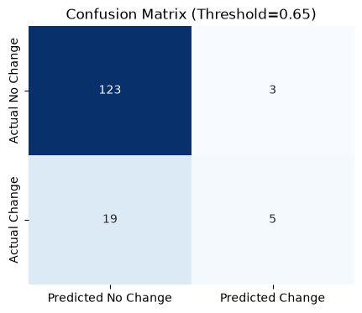
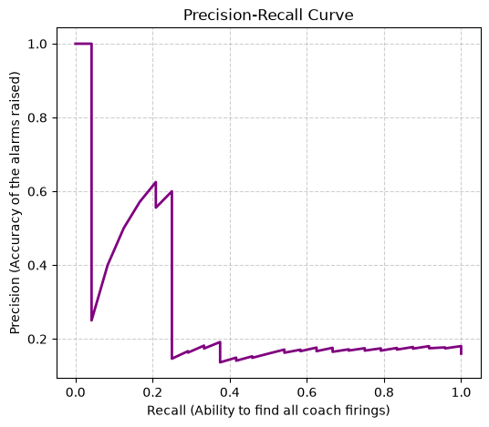
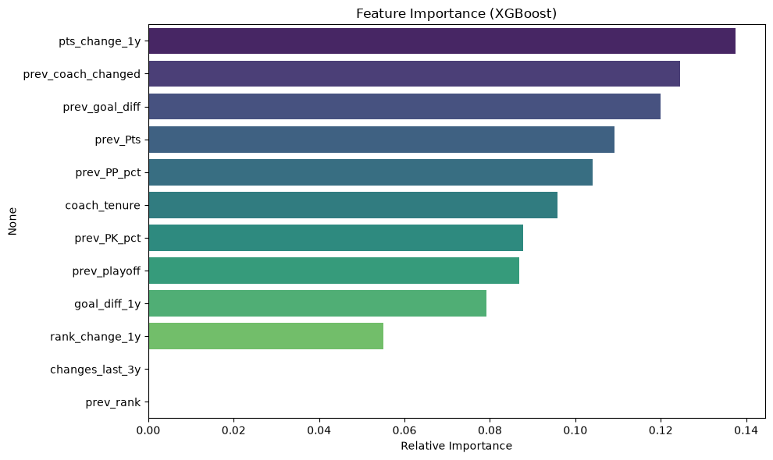
Interpreting XGBoost
Confusion matrix: the model is conservative and raises a red flag only when evidence is strong, which suits a decision-support tool.
PR curve: more informative than ROC here. Catching every firing means accepting many false alarms.
Key drivers: performance regression (pts_change_1y, prev_Pts), instability (prev_coach_changed, changes_last_3y) and a weak power play (prev_PP_pct).

Slide 16
Conclusion and limitations
What we learned
Limitations
Predicting a dismissal is hard: F1 of about 0.31 is realistic.
Past performance and franchise instability matter most.
Catching the data leakage was decisive for an honest result.
XGBoost only slightly beats the random baseline (0.31 vs 0.29).
No locker-room dynamics, injuries or ownership decisions.
A 0/1 target is simplistic, and the test set is small (150 rows).

Slide 17
Scope: three prediction tasks
Q1 · Team ranking
Q2 · Coach changes
Q3 · Penalty minutes
Final regular-season ranking of the teams.
Which teams will change coach ?
PIM of each player over the regular season.
[To be completed]
Common assumption: predictions are made the day before the first game of the new season.

Slide 19
Future improvements
Features
Modelling
Tools
Player data: star departures, injuries.
Time-series models (LSTM) or survival analysis.
Interactive dashboard (Streamlit, Dash) for GMs.

Slide 20
Questions ?
Thank you for your attention

